Slide 1
Coffee with the Principal
Presented by: Alesander Olaizola, Principal
May 15, 2020

Slide 2
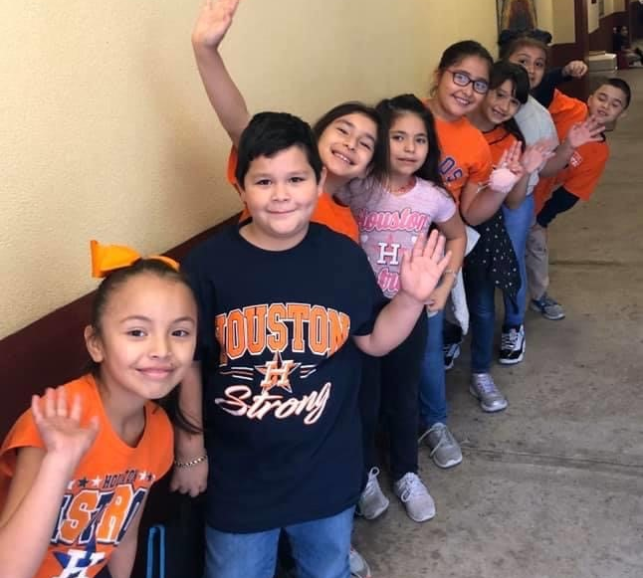
Meeting Agenda
End of the Year Updates
Summer School
Registration (All Grade Levels)
Census 2020
Wraparound Updates
Special Music Video by Tijerina students

Slide 3
End of the Year –Update
Last day of virtual instruction is Tuesday, May 19th
Report Cards will be mailed out after Monday, June 1st
Awards and student classroom material pick-up on Thursday, May 28th
Ms. Smith and Ms. Reyes – 8:00am
(PreK) Ms. Cobos, Ms. Ruiz & Ms. Villarreal – 9:00am
(Kinder) Ms. Brown & Ms. Tobias – 10:00am
(1st grade) Ms. Quintanilla & Ms. Williams – 11:00am
(2nd grade) Ms. Sifuentes & Ms. Hornsby – 12:00pm
(3rd grade) Ms. Cardona & Ms. Mardis – 1:00pm
(4th grade) Mr. Dominguez, Ms. Manzano & Ms. Moreno - 2:00pm
(5th grade) Mr. Smyrnis & Mr. Wilson – 3:00pm

Slide 4
Virtual Summer School
Summer School Coordinator – Ms. Escamilla
Students will receive a notification from their homeroom teacher
Summer School will begin Monday, June 8th and end Thursday, July 2nd
Virtual Instruction, Assignments Turn-in, and Parent Teacher Conferences will be scheduled Mondays to Thursdays from 9:00am to 2:00pm.
More information will be available and posted on Class Dojo

Slide 5
Become “A” Tijerina Eagle!
Registration is available for all grade levels.
Register over the phone:
English –(832)966-0471
Spanish–(832)900-0736
You can visit us at:
Website: www.houstonisd.org/tijerina
Facebook: Tijerina Elementary School
Twitter: @tijerinaes

Slide 6
Welcome Guest Speaker- Alejandra Peimbert

Slide 7
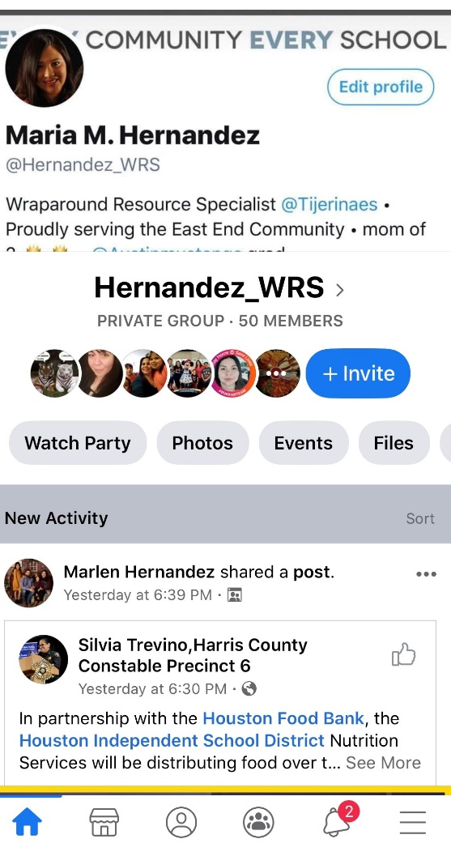
Wraparound Updates – Ms. Hernandez
Houston Children’s Charity – Uniform Assistance
Weekly Food Distribution
Follow us on Facebook – Hernandez_WRS

Slide 8
“Que canten los niños”
Autor: Jose Luis Perales
https://vimeo.com/417332554

Slide 9
Questions?
Comments?
Concerns?
Preguntas?
Comentarios?
Preocupaciones?

Slide 10
Have a Wonderful and Safe Summer! Good Luck 5th Graders! We are extremely proud of you and wish you the VERY BEST!

